Slide 1
PATCH PANEL
CN12
RJ45
CN4
SPKR GND
9
8
8
10
7
7
MIC GND
11
6
6
12
5
RIG SPKR
5
PTT GND
13
4
4
PTT
14
3
RIG PTT
3
MIC
15
2
RIG GND
2
SPKR
RIG MIC
16
1
RIG MIC
1
1

Slide 2
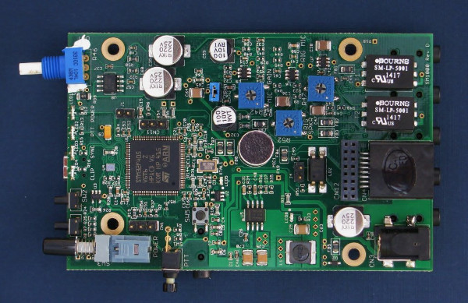
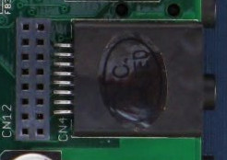
h
9
8
116
1

